Slide 1


Titolo presentazione sottotitolo
Simulation of Bragg Peak in Ion Beam Therapy
Study of Different Parameters of Simulation
Milano, XX mese 20XX
Milan, 6th June 2024
Petrus Canisius Astuto Santosa, Pasquale Serrao, Anna Simeone,
Alessia Zannino, Bianca Zocco

Slide 2
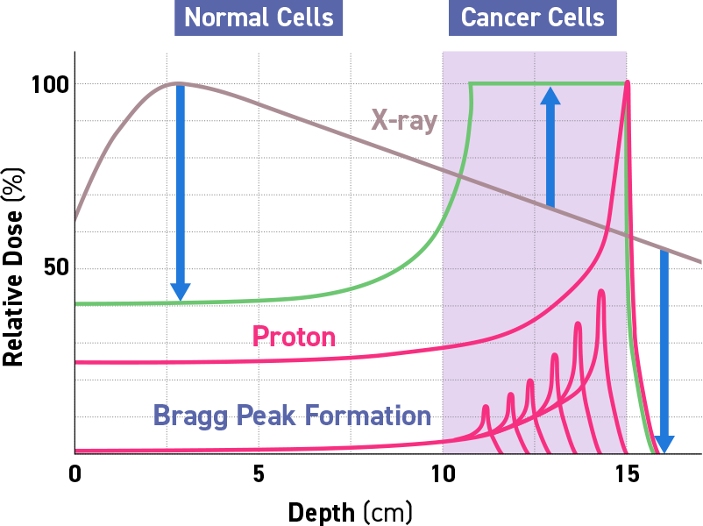
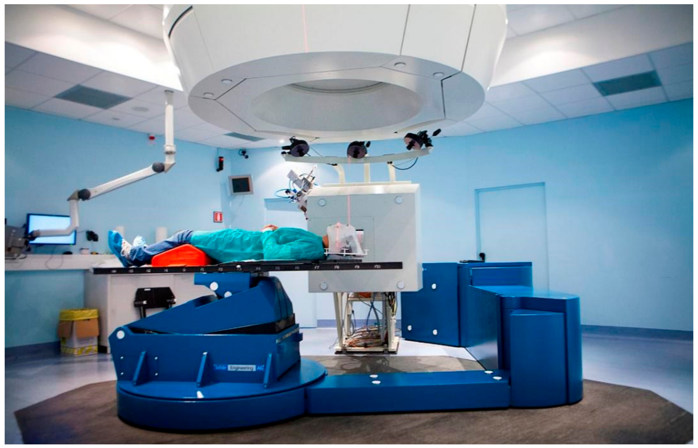
Hadrontherapy
Hadrontherapy is a form of radiotherapy for the treatment and cure of tumours.
Unlike traditional radiotherapy based on X-rays or electrons, hadrontherapy involves the use of proton and carbon ions.
(def. By CERN)

Slide 3

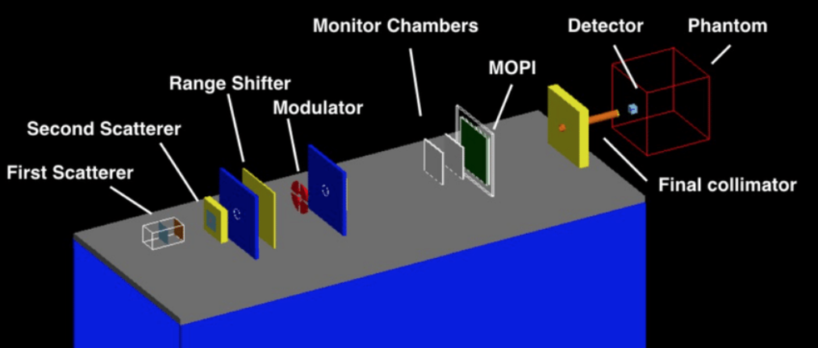
Simulation
Simulation of the ion (proton) beam facility in Catania for eye tumor treatment
Default set-up:
10000 particles
Energy of 60 MeV
Energy standard deviation 0.0 MeV
Phantom material water
Phantom dimension 40 cm x 40 cm x 40 cm
Detector dimension 4 cm x 4 cm x 4 cm
DETECTOR
Detector: 400 slices of 0.1 mm
CATANA setup implemented in Geant4

Slide 4
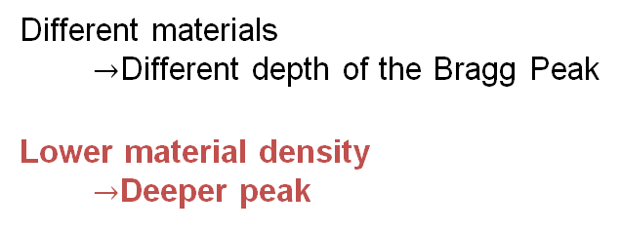
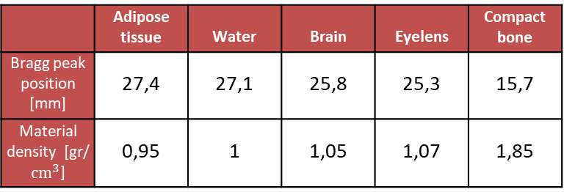
Materials
 | Adipose tissue | Water | Brain | Eyelens | Compact bone
Bragg peak position [mm] | 27,4 | 27,1 | 25,8 | 25,3 | 15,7
Material density [gr/$cm^{3}$] | 0,95 | 1 | 1,05 | 1,07 | 1,85
Different materials
$→$Different depth of the Bragg Peak
Lower material density
$→$Deeper peak

Slide 5

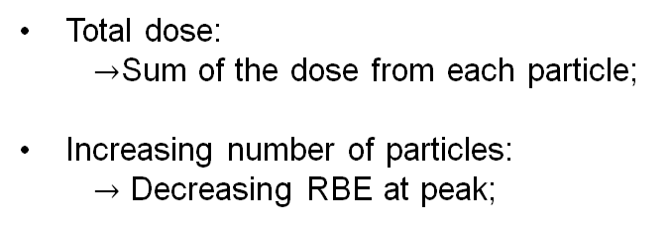
Number of particles
The relative biological effectiveness (RBE) is defined as the ratio between x-ray and particle doses required to cause the same effect in terms of Survival
N° of particles
Total dose:
$→$Sum of the dose from each particle;
Increasing number of particles:
$→$ Decreasing RBE at peak;

Slide 6
Number of particles
BIOLOGICAL DOSE
=
RBE * PHYSICAL DOSE
Physical dose peak amplitude ~ linearly dependent on the number of particles;
Biological dose shows a gradual decrease of the slope;

Slide 7
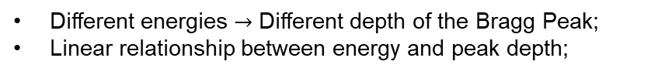
Energies
Different energies $→$ Different depth of the Bragg Peak;
Linear relationship between energy and peak depth;

Slide 8
Energy Standard Deviations Range
Ideal case: SD of 0 MeV;
Under SD of 1 MeV: at least 80% of the expected dose with 0 MeV of SD

Slide 9
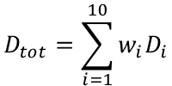
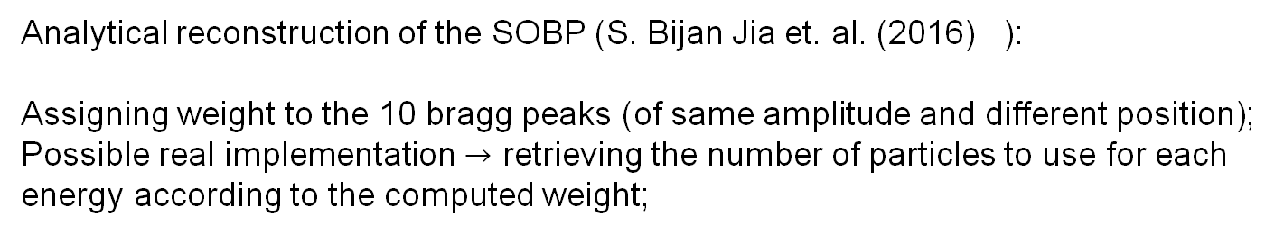
SOBP
Analytical reconstruction of the SOBP (S. Bijan Jia et. al. (2016) ):
Assigning weight to the 10 bragg peaks (of same amplitude and different position);
Possible real implementation $→$ retrieving the number of particles to use for each energy according to the computed weight;
$$D_{tot}=\sum_{i=1}^{10}{w_{i}D_{i}}$$

Slide 10
Detector shift: DEPTH SHIFT
DEPTH SHIFT:
Limit distance for dose deposition
Depth shift: no difference in the peak amplitude

Slide 11
Detector shift: TRANSVERSAL SHIFT
TRANSVERSAL
SHIFT:
Increasing transversal shift:
Lower dose;
Higher randomness in the shape of the curve;

Slide 12
Healthy VS tumoral cell
U87: Tumoral Cells (Glioma)
AG01522: Healthy Fibroblasts
@ Peak:
U87: higher Biological Dose
AG01522: lower Survivance Fraction
Entity of DNA damage is cell-dependent

Slide 13
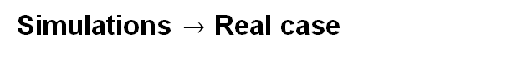
Effect on healthy tissues
Simulations $→$ Real case
d
Tumor
Healthy Tissue
Center of the Beam
Transition Zone:
Possible movements of the tumor: higher efficiency until the transition zone (d~15 mm)
Healthy tissue surrounding the tumor: higher risk of damage until the end of the transition zone
(d~ 25 mm)

Slide 14


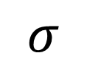
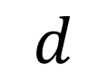
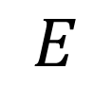
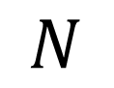
Conclusions
lllllllllllllllllllllllllllllllllllllllllllllllllllllllllllllllllllllllllllllllllllllllllllllll
Changing the number of particles to modulate the dose deposition
Keeping the standard deviation of the energy the lowest possible
Retrieving acceptable range of movement according to tumor dimensions
Modulating energy to shift the bragg peak position
$$N$$
$$σ$$
PERSONALIZATION OF THERAPY:
$$E$$
$$d$$

Slide 15
References
https://fondazionecnao.it/en/hadrontherapy/what-is-hadrontherapy (definition of hadrontherapy and how it works)
Cirrone et al.,(2011). Hadrontherapy: a Geant4-Based Tool for Proton/Ion-Therapy Studies. In Progress in NUCLEAR SCIENCE and TECHNOLOGY (Vol. 2).
Cirrone et al.,(2005). Implementation of a new Monte Carlo - GEANT4 simulation tool for the development of a proton therapy beam line and verification of the related dose distributions. IEEE Transactions on Nuclear Science, 52(1 I), 262–265.

Slide 16
References
Cirrone et al.,(2004). A 62 MeV Proton beam for the treatment of ocular melanoma at Laboratori Nazionali del Sud-INFN (CATANIA).
Chaudhary, et al.,(2014). Relative biological effectiveness variation along monoenergetic and modulated Bragg peaks of a 62-MeV therapeutic proton beam: A preclinical assessment. International Journal of Radiation Oncology Biology Physics, 90(1), 27–35.
S. Bijan Jia et al. Designing a range modulator wheel to spread-out the Bragg peak for a passive proton therapy facility, Nuclear Instruments and Methods in Physics Research Section A: Accelerators, Spectrometers, Detectors and Associated Equipment, Volume 806, 2016, Pages 101-108, ISSN 0168-9002.
https://www.lnf.infn.it/media/notiziario/not11/Art.12.pdf

Slide 17
References
Paganetti, H. (2009), MO-SAM-BRB-01: Biological Aspects of Heavy Charged Particle Radiation Therapy. Med. Phys., 36: 2685-2685
Schilling I, Bäcker CM, Bäumer C, Behrends C, Hötting M, Hohmann J, Kröninger K, Timmermann B, Weingarten J. Measuring the Beam Energy in Proton Therapy Facilities Using ATLAS IBL Pixel Detectors. Instruments. 2022; 6(4):80.

Slide 18
Detector shift – X direction

Slide 19
Detector shift: TRANSVERSAL SHIFT
Increasing transversal shift:
Lower dose
Higher randomness in the shape of the curve
Notes:
Moving on the transversal shift

